Slide 1
Ulysseus Seed Funding Programme for Joint R&I Groups / Call 2025
3.4.2025 Radovan Dráb (WP4) research@ulysseus.eu

Slide 3
Ulysseus Seed Funding Progamme for Joint R&I Groups: Call 1
Content
Seed Funding objective and Target Group
What kind of R&I Groups are supported
Types of activities supported within the SF
Key points and conditions
Process of Application
Questions
Where to find the call: https://ulysseus.eu/calls/ulysseus-seed-funding-programme-for-joint-research-and-innovation-groups/

Slide 4
Ulysseus Seed Funding Progamme for Joint R&I Groups: Call 1
SF Objective and Target Group
Support for Ulysseus Research & Innovation Groups creation and:
Enhancing research quality & impact,
Strengthening international collaboration
Ulysseus R&I Group Members:
Researchers from Ulysseus partner universities (must be administratively eligible to use SF funds)
Members of associated partners (can not be beneficiaries)
Stakeholders from private & public sectors (can not be beneficiaries)
(Only researchers from partner universities can receive funding.)

Slide 5
Ulysseus Seed Funding Progamme for Joint R&I Groups: Call 1
Involved Subjects and Roles - Ulysseus Seed Funding Administration
Researches
Researchers from any Ulysseus partner university with a legal contract with the particular University
Lead Applicant
Researchers Submitting projetc proposal – repreenting Research Groupe in Application proces
Stakeholders and Associated partners
Organizations and institutions that collaborate with the Ulysseus alliance
Seed Funding Administration platform
Set of program tools for forms development and their management and analysis (Rstudio, Excel...)
Ulysseus Experts Database
comprehensive directory of Ulysseus researchers and associated partners and related stakeholders
Ulysseus Approval Committee
Compostion: members from the Ulysseus T4.1 task force team and, optionally, the chairs of Local Selection Committees
Role: technical pre-check of the Applications, managing the documents flow for the LSC, collecting their assessments and results, aggregating the result to inform the applicants, communication of final approoval.
Local Selection Commitee
Compostion: chaired by the Chief Scientific Officer of the corresponding Ulysseus Innovation Hub
Role: assessment of the received R&I groups applications and funding allocation

Slide 6
Ulysseus Seed Funding Progamme for Joint R&I Groups: Call 1
What kind of R&I Groups are supported
Interdisciplinary R&I groups around the Ulysseus Innovation Hubs
at least 3 researchers from at least 2 different partner universities + min. 1 associated partner/stakeholder
R&I groups in common research disciplines (faculty related...)
at least 3 researchers from at least 2 different partner universities
each academic group member has to be registered in the Ulysseus Experts database.
R&I group has one lead applicant who submits the application on behalf of the group to the seed funding call (e.g.: if there are 7 partners involved, only 1 application can be submitted).
Researchers, experts, innovator from other institutions (than Ulysseus partner universities) can join and participate in the Ulysseus R&I Groups, but not as beneficiaries, and their contribution to the groups’ activities should be clearly outlined.

Slide 7
Ulysseus Seed Funding Progamme for Joint R&I Groups: Call 1
Which are the Innovation Hubs Topics?
Ageing & Well-Being
Artificial Intelligence for Business & Education
Cybersecurity
Digitalization Transformation for Industry
Robotics
Socio-ecological Sustainability
Sustainable Energy, Transport, Mobility for Smart Cities
Sustainable Entrepreneurship & Impact
Browse the profiles of Ulysseus Innovation Hubs:
pdf version
web version

Slide 8
Ulysseus Seed Funding Progamme for Joint R&I Groups: Call 1
Types of activities supported within the SF
Activities that are supported within this call are aimed to enable in-person meetings where researchers collaboratively establish an R&I group, define member roles, objectives, and research areas, exchange experiences and knowlege among members and generatie ideas for future research or common projects, articles or initiatives.
List of eligible costs:
Travel expenses (travel, accommodation, subsistence),
Services for R&I group meetings, seminars, workshops aiming to foster the networking of the alliance researchers and stimulate new projects funded through various schemes like Horizon Europe, Erasmus Plus, Digital Europe, Interreg, Life, etc. These costs can include venue costs (room rentals, setup and arrangement fees, etc.), materials (printed materials, workshop supplies, etc.), catering (refreshments, coffee breaks etc.),
Any other eligible cost, upon prior consultation to the EC Project Officer through the Ulysseus General Manager.
Be aware, that ineligible costs include, but are not limited to:
Overhead costs,
Staff costs,
Equipment costs,
Conference fees,
Third parties’ services (consultation companies etc.),
Proposal writing costs and costs of such associated activities.

Slide 9
Ulysseus Seed Funding Progamme for Joint R&I Groups: Call 1
Key points and conditions
Budget
The Local Selection Committee will propose the funds available for each application according to the internal strategy of the partner university. This strategy prioritizes either fewer R&I groups with a larger budget or many smaller R&I groups. As an orientation guideline, funding of up to 3 000 EUR per applicant can be allocated, but this will depend on the number, composition and relevance of the R&I groups per Ulysseus partner university. Each partner university will distribute the allocated amount according to their internal rules and administrative procedures (grant, dedicated budget, lump sum...).
Conditions:
Registration in Ulysseus Experts database as mentioned in previous slides
At least 3 researchers, 2 universities and in case of IH topical Group also 1 associated partner is required to apply for Seed Funding.
The SF and its activities have to be carried out in 12 consecutive months
Reporting – one short onepager report is submitted at the end of each year until 2027. One grant report after 12M of SF

Slide 10
Ulysseus Seed Funding Progamme for Joint R&I Groups: Call 1
Available resources and Budgeting
Budget
Partner University | Expected Number of Grants | Allocated Budget
University of Seville (USE) | 21 | 63 000 EUR
Université Côte d’Azur (UNICA) | 21 | 63 000 EUR
University of Genova (UniGe) | 21 | 63 000 EUR
Technical University of Košice (TUKE) | 18 | 54 000 EUR
MCI | The Entrepreneurial School® (MCI) | 11 | 33 000 EUR
Haaga-Helia University of Applied Sciences (HH) | 11 | 33 000 EUR
University of Münster (UM) | 21 | 63 000 EUR
University of Montenegro (UCG) | 17 | 51 000 EUR

Slide 11
Application Process

Slide 12
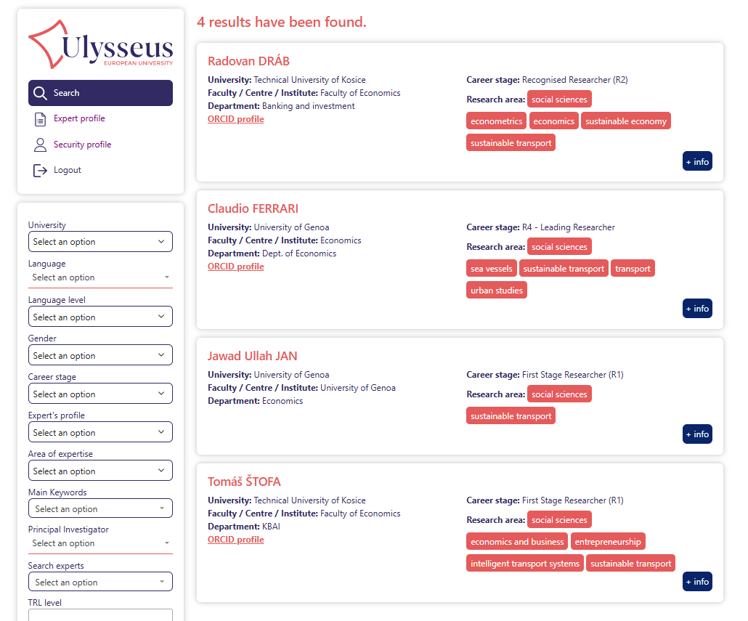
Step 0
Applicant (Group Leader): Group leader is searching through Ulysseus Experts Database (or different database) for researchers with relevant experience across the Ulysseus and is Reaching out
Search
And contact

Slide 13
Ulysseus Seed Funding Progamme for Joint R&I Groups: Call 1
The process
1. Lead Applicant downloads and fills in the Application form, ensures the group members registration to Experts Database and submits the application via Submission link
Application form submission
1
2. UAC, collects and checks the AF, on weekly basis, manages the requests for AF corrections and merger proposals.
2
Technical Check
3. UAC combines information from AF and information from Ulysseus Experts Database to prepare an Extended Application Form (EAF) - complex document describing the proposed R&I group. Such EAFs are allocated to corresponding LSeCs together with the assesment forms
AF prepared
for assessment
3
4. Each LSeC recieves only EAFs where its researchers participate. Assesses them according to evaluation criteria, and decides about budget allocation for its institutions researchers only. The assessment summary is sent to UAC for finalisation.
AF assessment
and budget alocation
4
5. UAC collects the LSeC assessments and combines them by R&I groups and informs relevant subjects with the results
Final approval
and communication
Start of funded activities and reporting
5

Slide 14
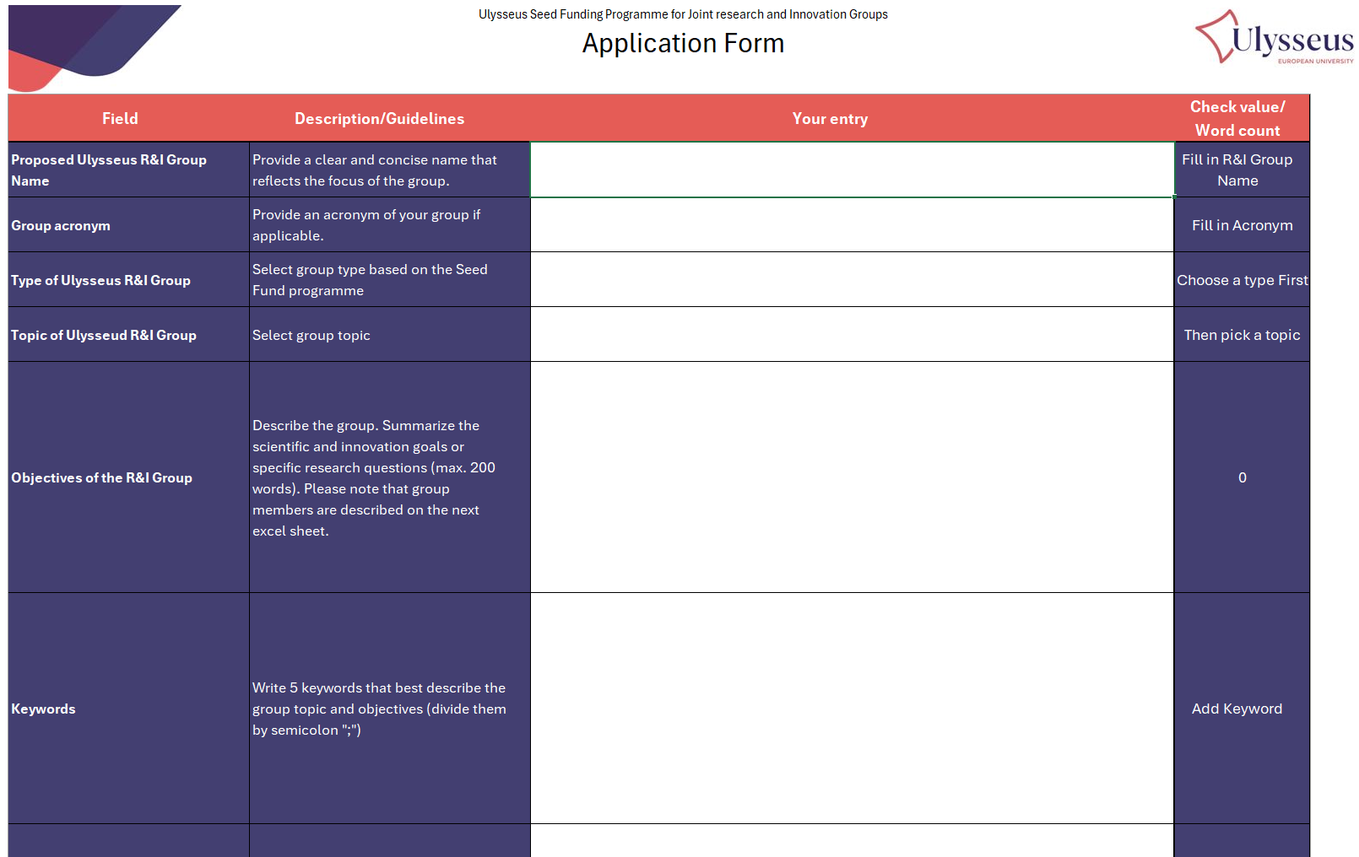
Ulysseus Seed Funding Progamme for Joint R&I Groups: Call 1
Application form and required data
Ulysseus R&I Group name
Acronym
Group type
Group topic
Group objectives
Keywords
Expected Contributions to Ulysseus European University
Expected Outcomes and Impact
Long-term Vision & Follow-Up Activities
Budget Proposal
Members list

Slide 15
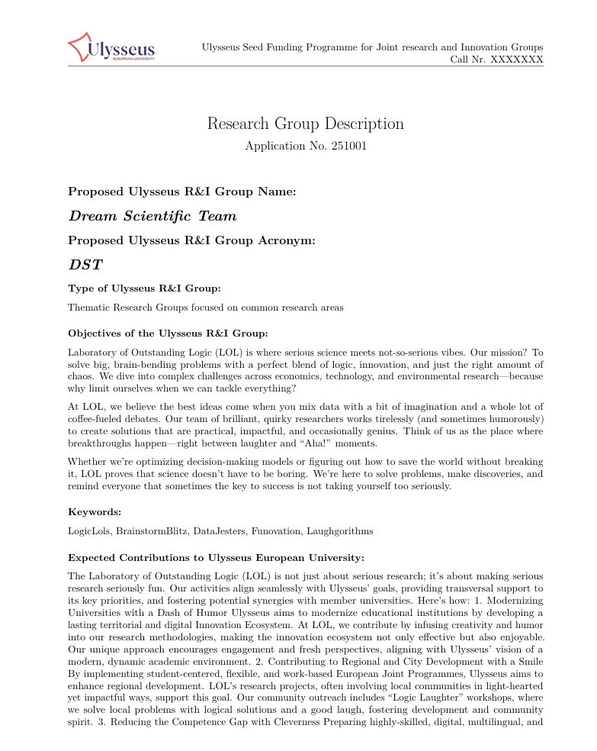
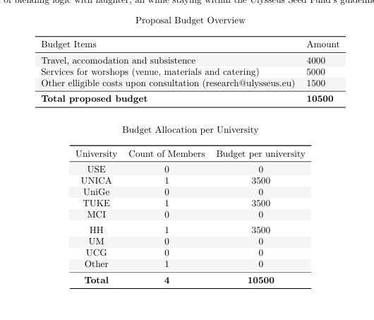
Ulysseus Seed Funding Progamme for Joint R&I Groups: Call 1
Combining the AF with information stored in Ulysseus Experts database into EAF
Application form
Ulysseus Experts Database
Extended Application form

Slide 16
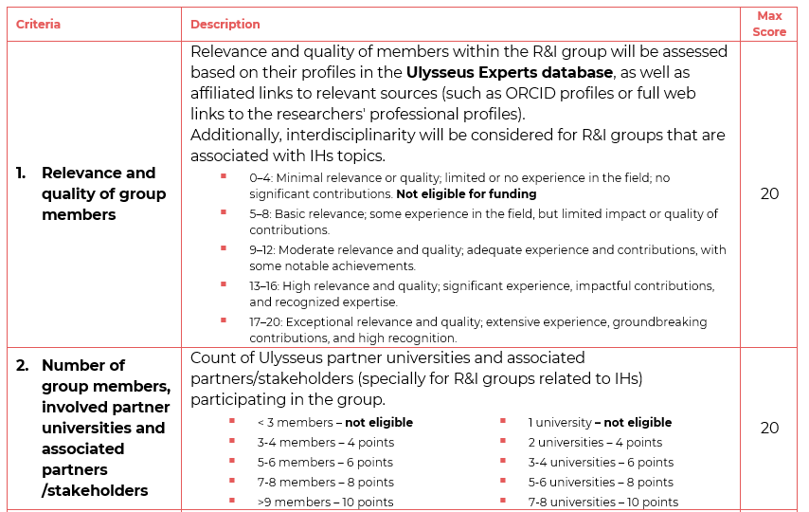
Ulysseus Seed Funding Progamme for Joint R&I Groups: Call 1
EAF assessment and Evaluation criteria

Slide 17
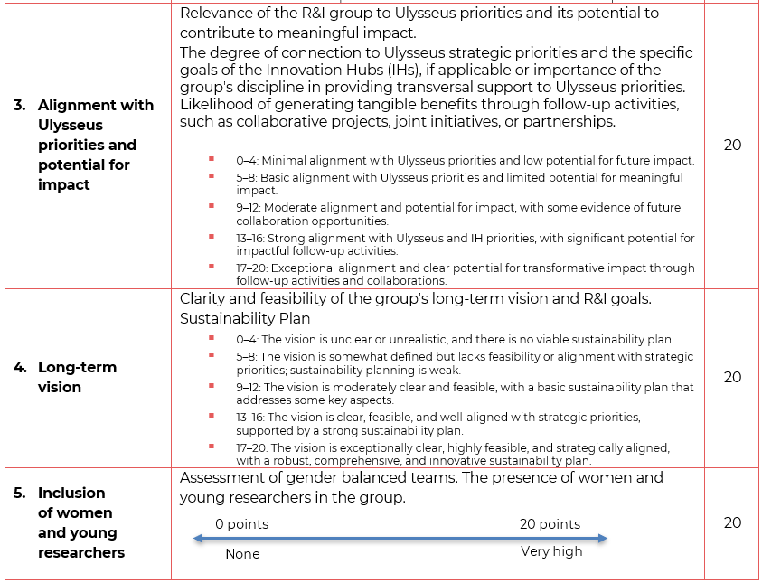
Ulysseus Seed Funding Progamme for Joint R&I Groups: Call 1

Slide 18
The Timeline
UAC technical check , EAFs, sending for assessment
UAC final approval
Annual report.
Call 1 announcement
Call 1 END
UAC informs lead applicants and receives confirmation.
Finalisation of the SF documents
February
March
April
May
June
July
August
September
December
August 2026
Implementation Start
Grant report after the seed funding
Establishment of Committees
LSC assessmet phase
Webinar for researchers
Webinar for LSC

Slide 19
Ulysseus Seed Funding Progamme for Joint R&I Groups: Call 1
Welcome Webinar in September for all supported R&I Groups

Slide 20
Ulysseus Seed Funding Progamme for Joint R&I Groups: Call 1
Process example
Example of a J&I Group application situation:
A proposed group:
4 universities,
7 members in total (TUKE(1), MCI(2), HH(2), USE(2))
lead applicant from USE
According to the application form the grouyp proposed a budget of 21 000€ (TUKE-3000 €, MCI-6000 €, HH-6000 €, USE-6000€)
After the selection process the situation is as follows:
Approved funding: HH (7000 €), USE (4200 €)
Not approved funding: MCI (willing to participate – other funding), TUKE (not willing to participate without SF)
Lead Applicant informs Ulysseus Approval Committee with the decision.
Group can still be formed with TUKE, HH, MCI with only USE, HH being funded by SF (11 200 € in total for the Group).
Note: Each university‘s alocated funding is exclusively available to its own researchers for seed funding activities!

Slide 21
Questions
The Ulysseus Action has received funding from the European Union under the grant agreement No 101124733. The views and opinions expressed in this communication are the sole responsibility of the authors and do not necessarily reflect the views of the European Commission

Slide 22
Thank you
Feel free to contact us with any enquiry regarding the Call or the Seed Funding Programme:
research@ulysseus.eu
The Ulysseus Action has received funding from the European Union under the grant agreement No 101124733. The views and opinions expressed in this communication are the sole responsibility of the authors and do not necessarily reflect the views of the European Commission

