Slide 1
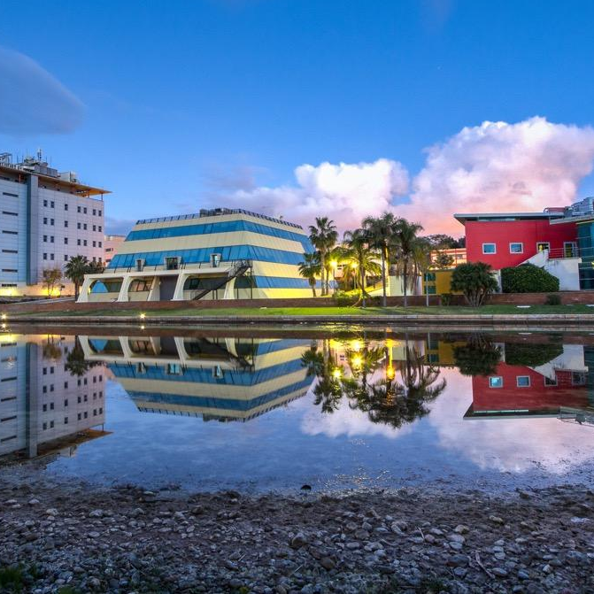

Slide 2
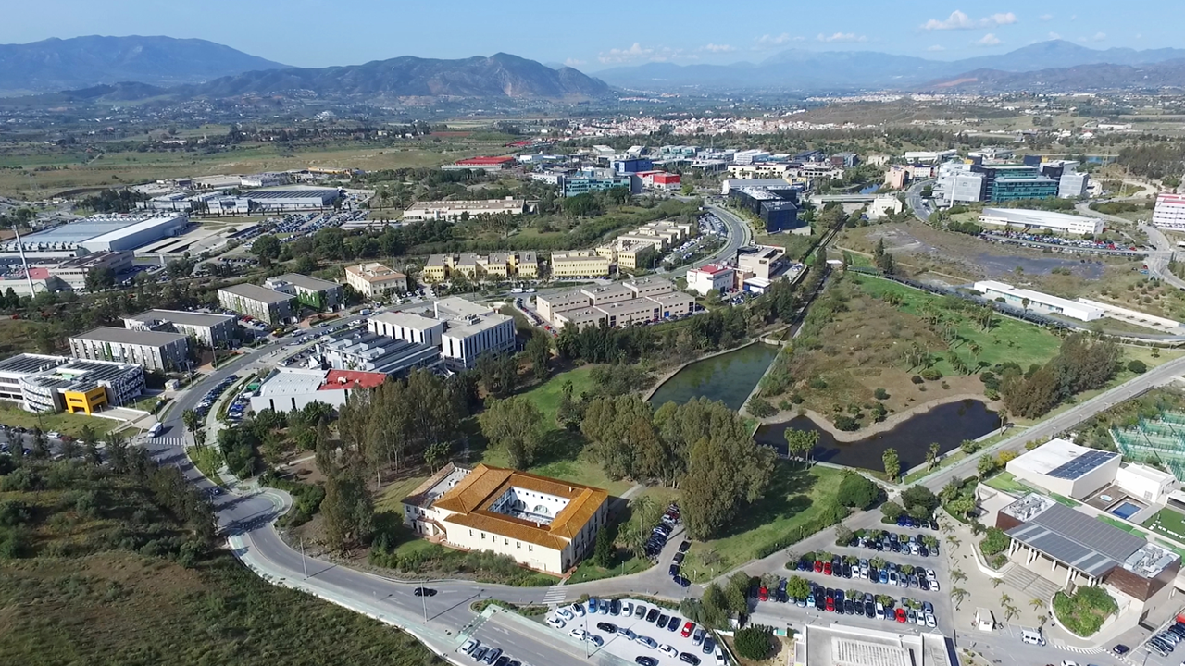
Malaga TechPark
https://youtu.be/O3_rmNOKxng?si=YZdIKcLfeOImoc45
One of the largest concentrations of technology companies in Spain.
Opened in 1992.
Public-private initiative with the participation in its shareholding of the Regional Government of de Andalusia, the City Council of Malaga, Banco Unicaja, and the University of Malaga.
Málaga TechPark is the world headquarters of the International Association of Parks and Innovation Areas (IASP).

Slide 3
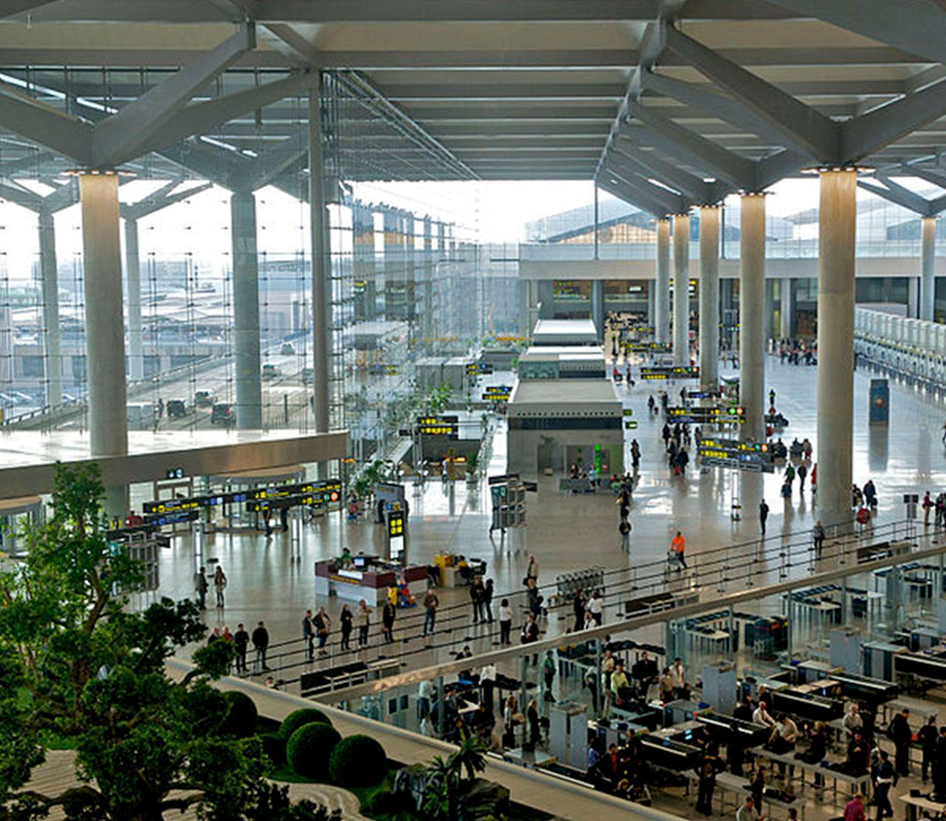
Well connected
Malaga-Costa del Sol Airport 4th Spanish airport, reaching almost 24 million passengers in 2024 and serving 128 destinations. Main destinations in volume: UK, Germany and France. Capacity for 35 million passengers/year and over 90 direct flights to most European destinations.
High Speed Train
Madrid is only 2.5 h. away. Other lines connecting to other major Spanish cities: Barcelona, Seville, Zaragoza.
Motorway Networks Motorway networks in Málaga and the Costa del Sol area run all around the Southern coast, connecting Costa del Sol resorts, such as Málaga City, Marbella and Estepona. As well as providing links to other cities such as Cordoba, Seville, Madrid and Valencia.
Seaport
2nd most important cruise shipping port in Spain and the 6th Mediterranean port in terms of good traffic.

Slide 4
Málaga TechPark in figures
32 Years of experience
700
Enterprises
25,100
Professional
+2M
M² dedicated to innovation
+900M
€ in investment
+80% Private investment +22%
Of the GDP of Malaga
50,000
Indirect employment growth

Slide 5
Authentic model of innovation

Slide 7
Headquarters of Innovation Networks
International Association of Science Parks and Areas of Innovation
Association of Science and Technology Park of Spain

Slide 8
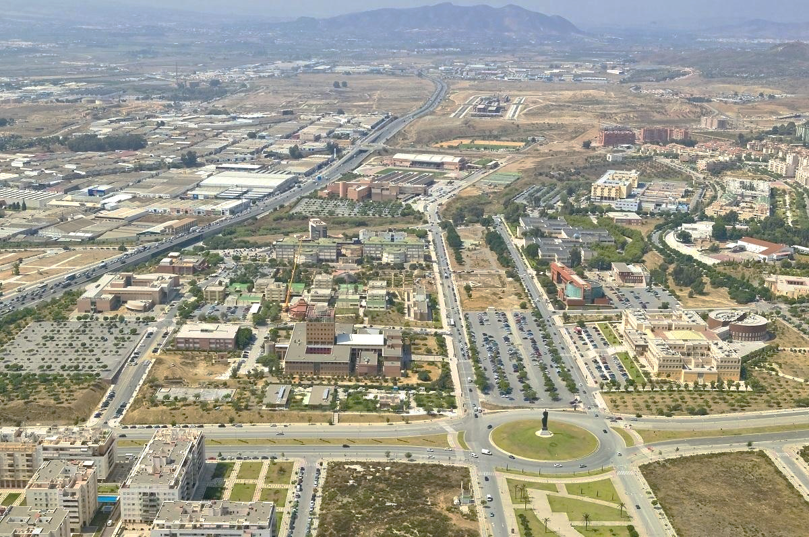
Agreements with the University de Malaga
The University of Malaga is among the 14 universities in Spain with the highest scientific and technical production.
+ 330 research Groups, 39 in ICT
+ 20 Research Institutes, 8 in engineering
Areas of expertise:
Software Technology
Home automation and energy efficiency
Telecommunication research
Mechatronics and cyber-physical systems

Slide 9
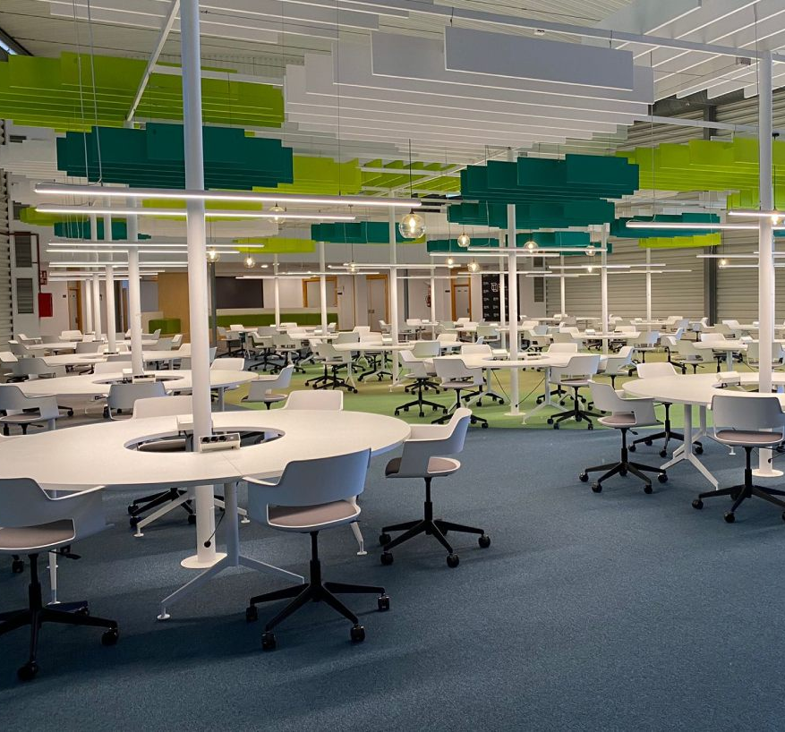
Workspaces for innovation
●Offices Spaces
●Manufacturing Areas
●R&D Facilities
●Laboratories & Test facilities
●Business Centers
●Incubators
●Co-working Spaces
●Public Research Centers
●Training Facilities
●Open Innovation spaces

Slide 10
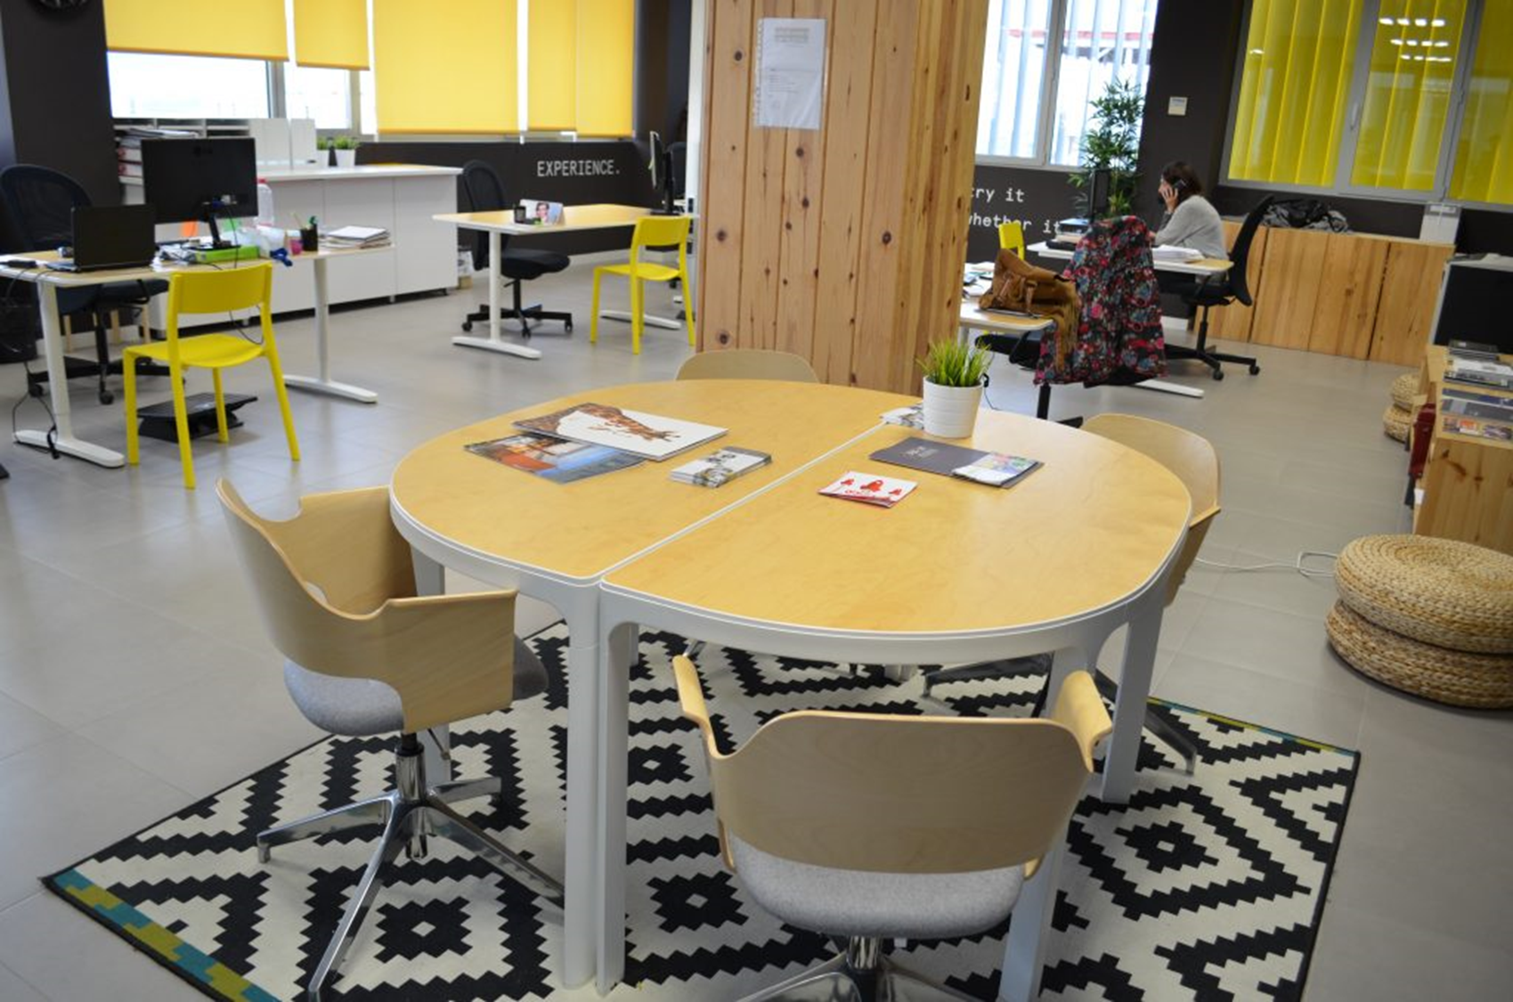
The Green Ray
Þ The Green Ray is the name of a building constructed by Málaga TechPark on the Teatinos campus of University of Málaga (UMA)
Þ The subtitle of the name “global entrepreneurship by PTA-UMA” refers to the objectives for the use of the building.
Þ Málaga TechPark has developed this Project at the UMA Campus, with the aim of developing a common strategy between Málaga TechPark and the UMA in the field of knowledge and support for entrepreneurs.

Slide 12
Leading Digital Transformation Areas of expertise
Artificial Intelligence
IoT
Conectivity
Robotics
Aerospace
Machine Learning
Automation
Blockchain
5G
Cibersegurity
Big Data
Cloud
Digital Solutions

Slide 13
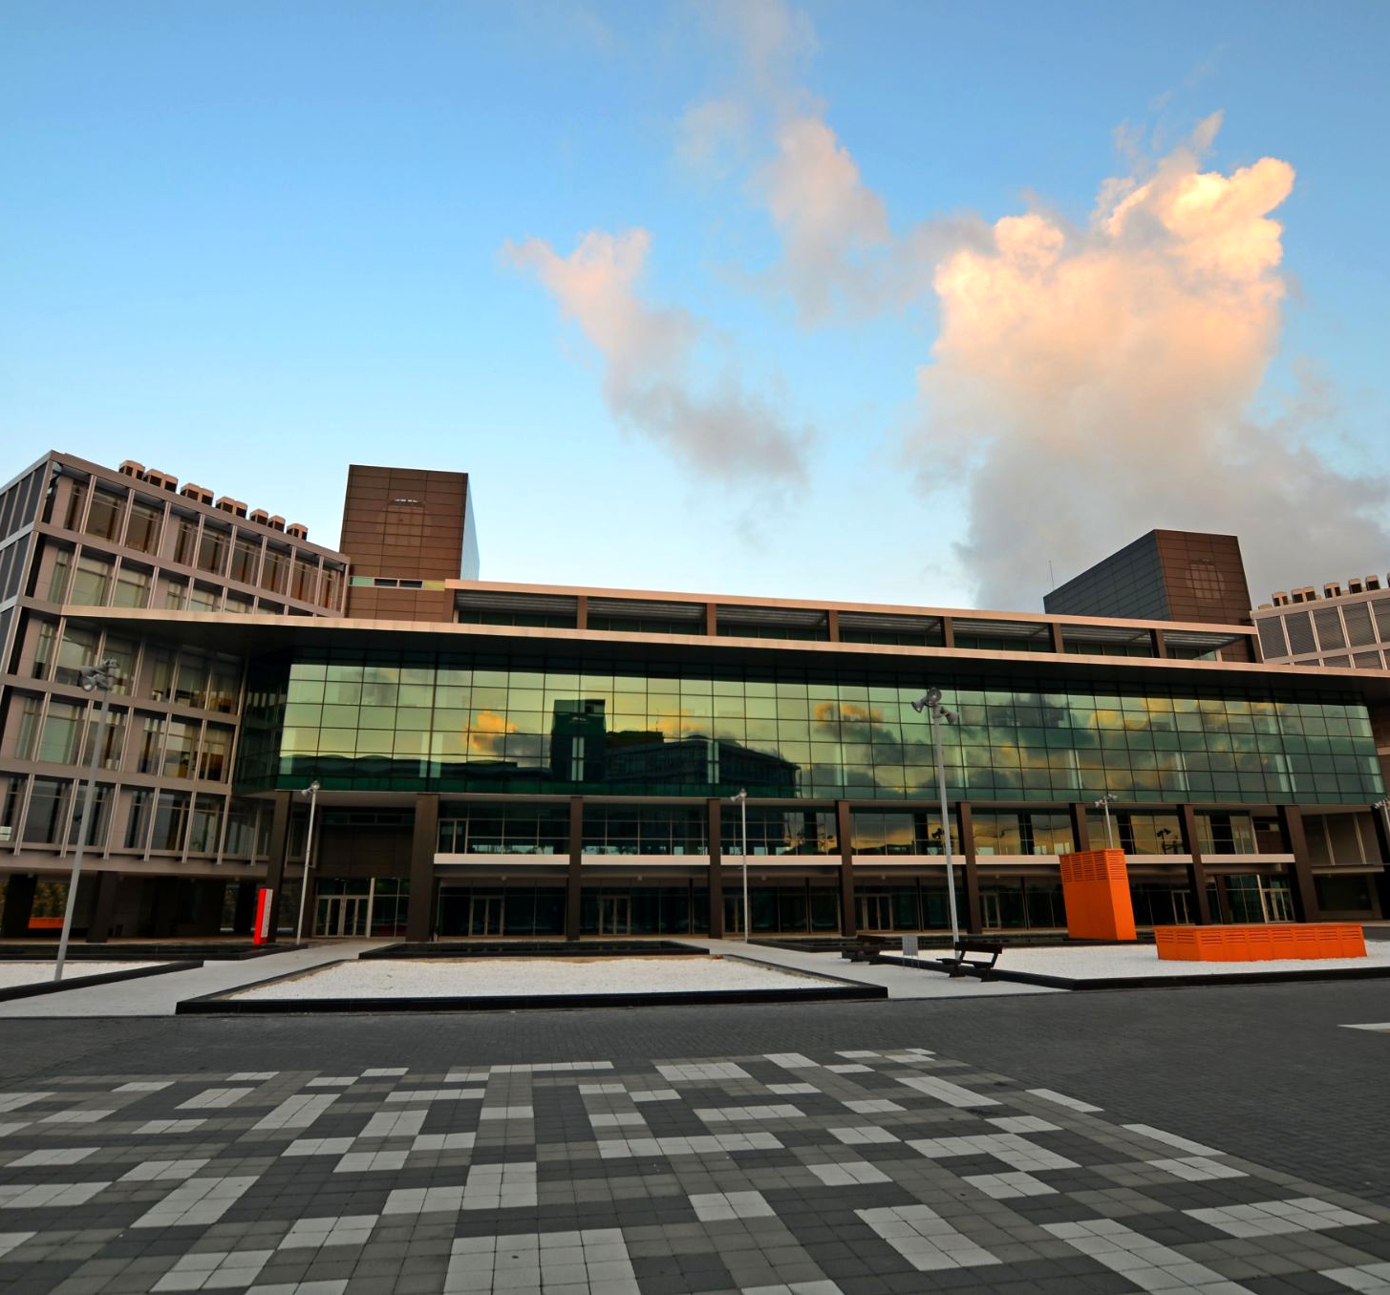
Flexibility to expand
Wide range of spaces, with offices from 20 m2 to +5,000 m2 for rent or sale, at very competitive prices.
Quick and easy initial implementation for the start of the activity.
Flexibility to increase the space according to the forecasting of each company.

Slide 14
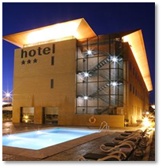
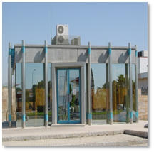
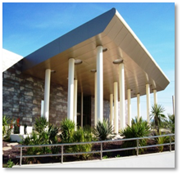
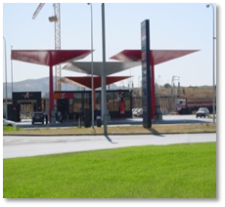
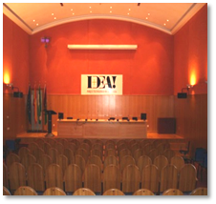
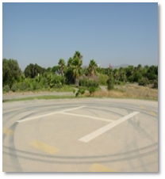
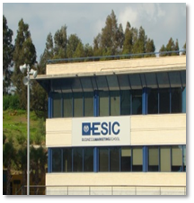
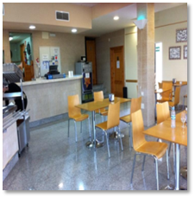
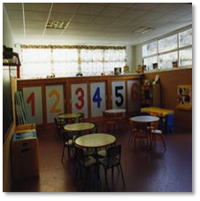
Excellent Infrastructures and Services
Hotels
Security and Control
Sports Center
Petrol Station
Spaces for meetings and events
Heliport
Business School
Bilingual Schools
Restaurants
Nursery school

Slide 15
Easy integration into the local environment
Legal services
Relocation services
Recruitment services
Language courses and cultural immersion
Contact with immigration authorities
Networking and leisure activities for employees
Residence and coliving services

Slide 16
eee
Support for R+D+i activities
Málaga TechPark offers advice to obtain regional, national and European incentives and funds for R&D&I, as well as digital and green transformation.

Slide 17
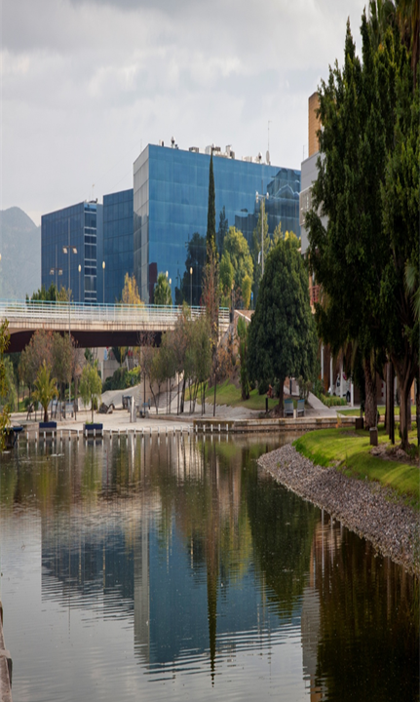
Málaga TechPark Execs
A proactive business alliance to boost the leadership of Málaga TechPark and strengthen the links and synergies between the executives from Málaga TechPark companies.
More than 50 member companies
generating €5.6 billion in revenue
Employ 5,7 million people worldwide
With + 500,000 patents
Present in 169 countries and 5 continents
'No Man is an Island’
No man is an island entire of itself, every man is a piece of the continent, a part of the main (…)
For Whom the Bell Tolls, John Donne.

Slide 18
Members of Málaga TechPark Execs

Slide 19
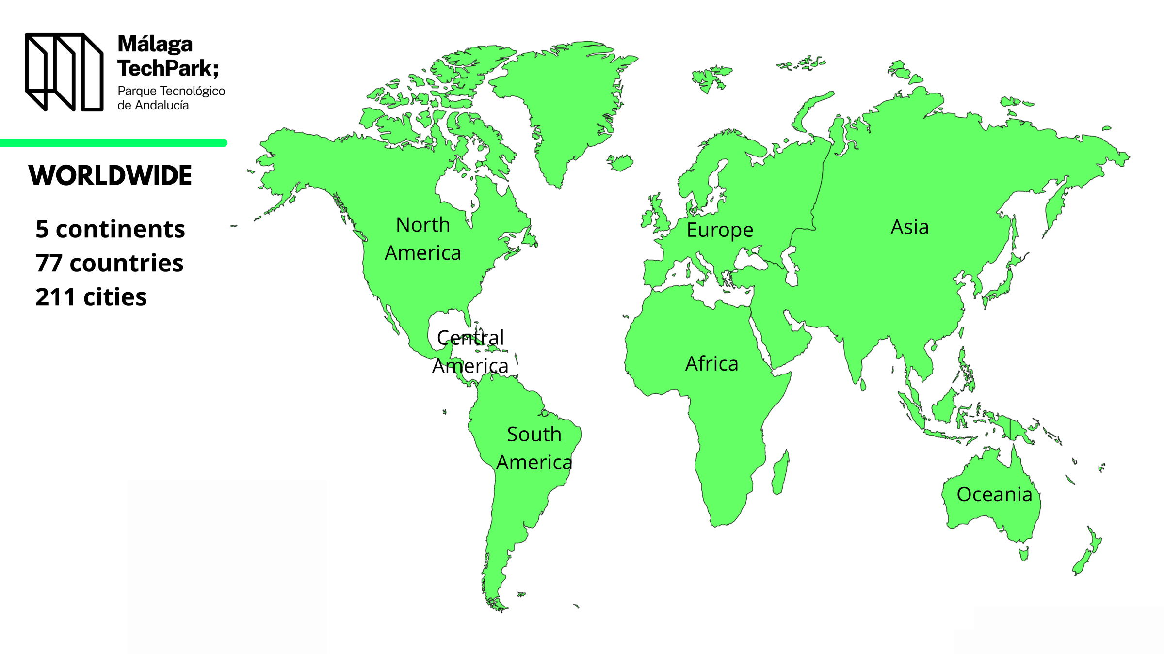

Slide 20
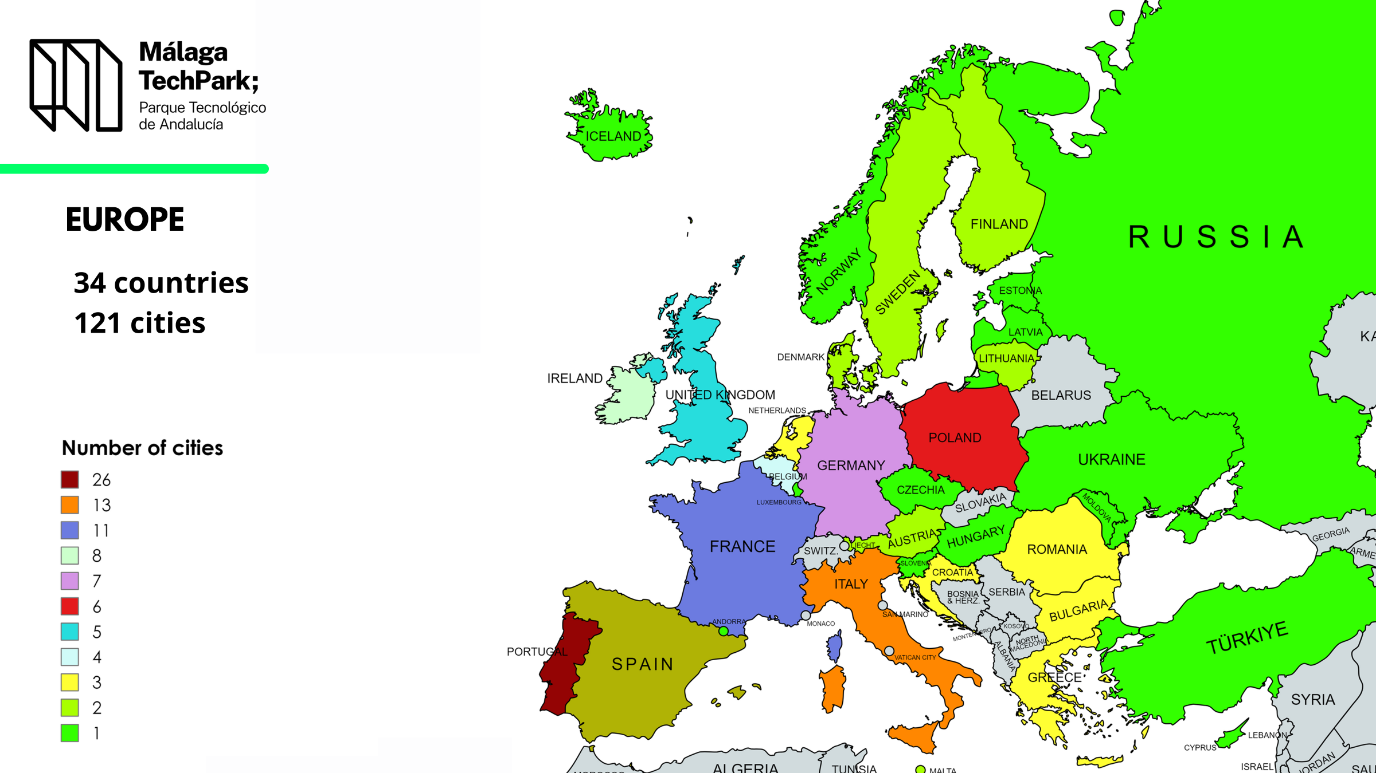

Slide 21
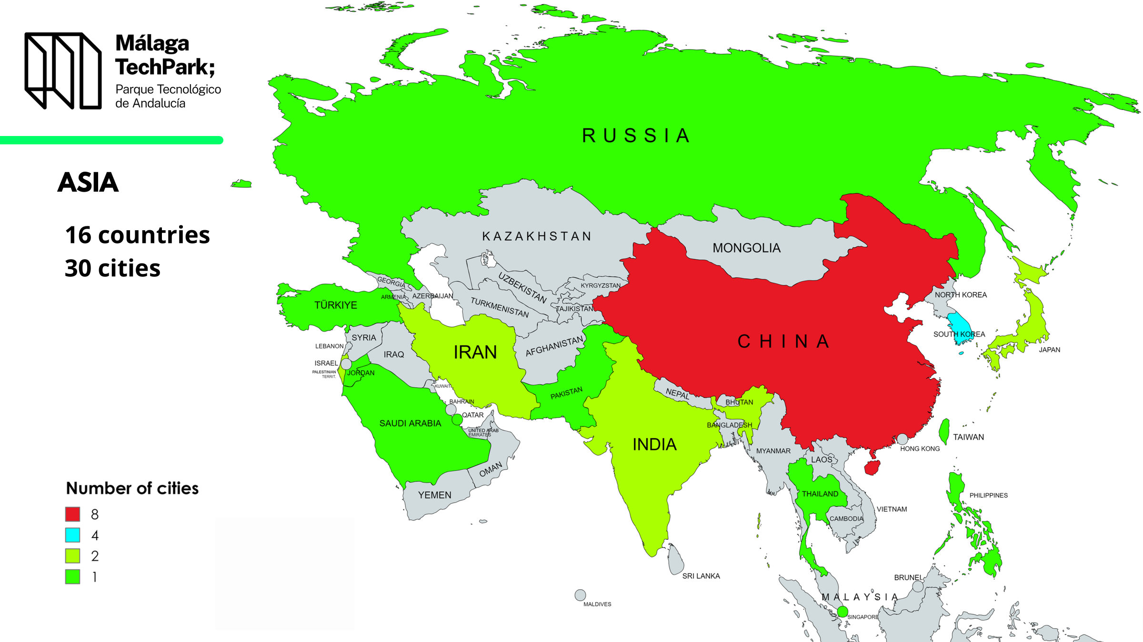

Slide 22
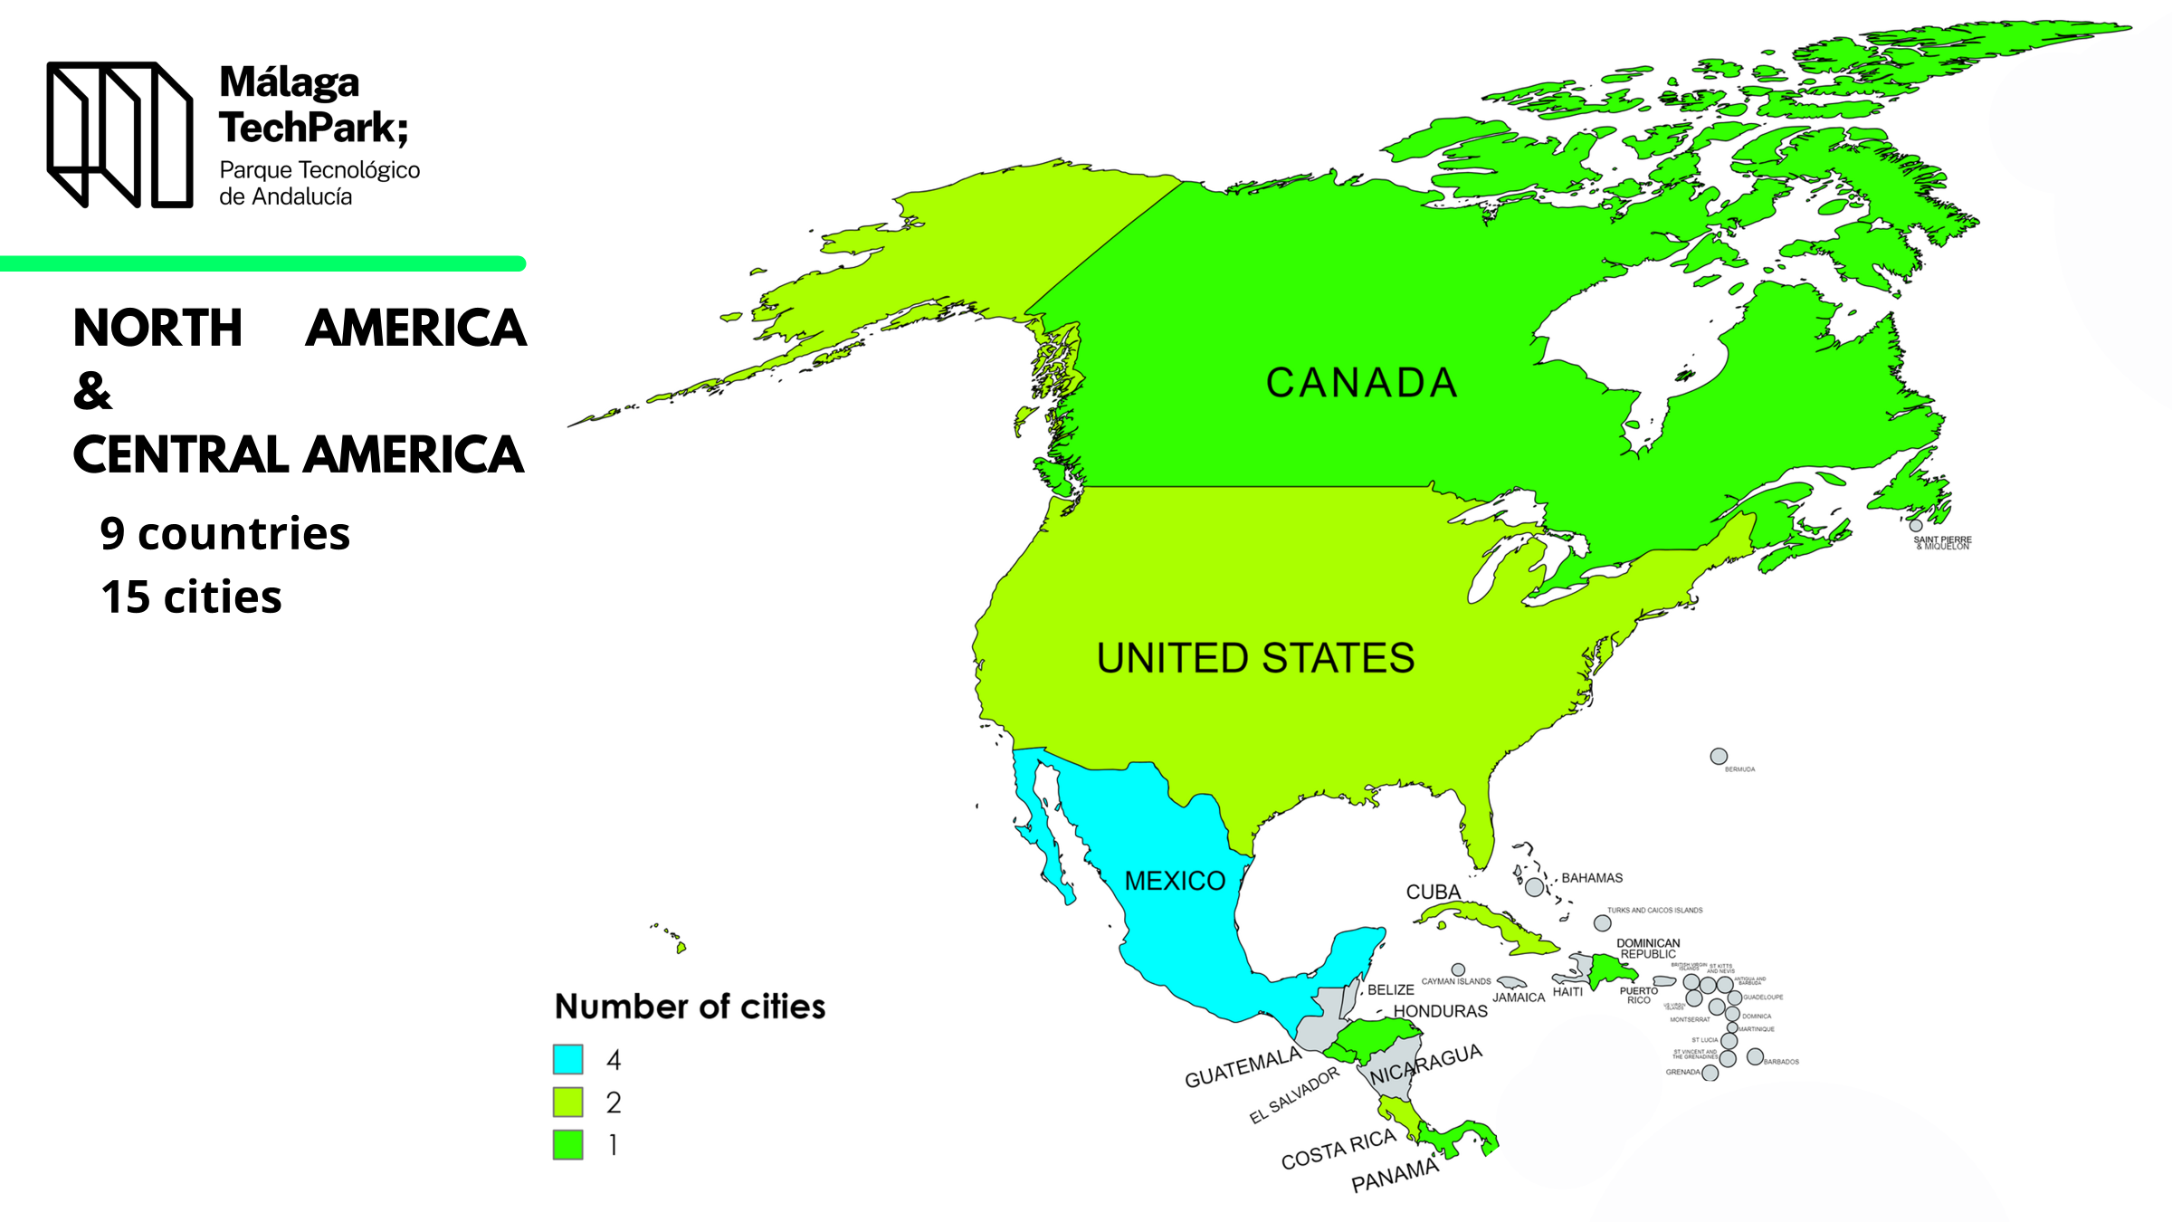

Slide 23
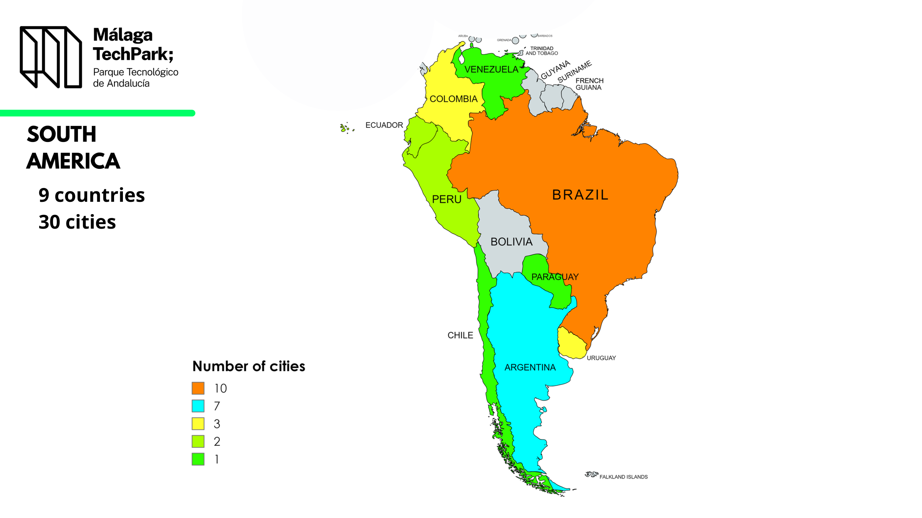

Slide 24
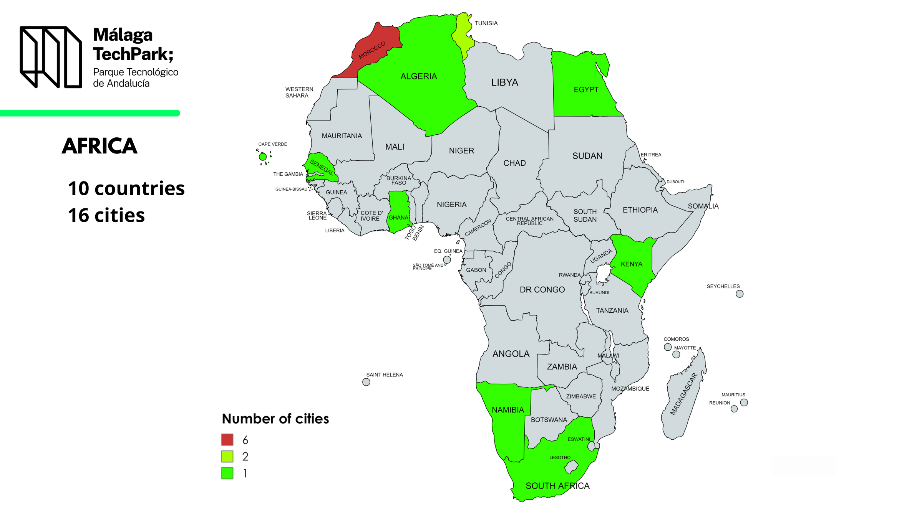

Slide 25
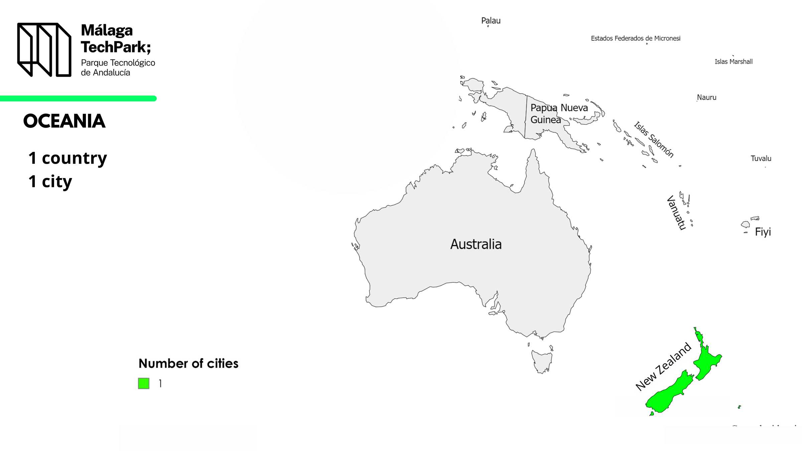

Slide 26
Málaga TechPark in International Networks
International Association of Science and Technology Parks | Research and innovation network of European Regions (ERRIN)
Peninsular Open Innovation Network | Ibero-American network of Science and Technology Parks
European platform for clusters collaboration | Association of Science and Technology Parks of Spain
European Alliance for Green Hydrogen | EPALE- Electronic platform for adult education in europe
Helnnovative | External chamber of comerce commission

Slide 27
Málaga TechPark Projects
Erasmus +
Erasmus L-S
Horizon Europe
Interreg Atlantic Area
Erasmus +
Erasmus L-S

Slide 28
www.pta.es
https://www.linkedin.com/malaga-techpark/
anavarro@pta.es

